Slide 1
IS204
System Analysis and Design
System Development
Approaches
COMPUTER INFORMATION SYSTEM DEPARTMENT ASS.LEC. ZAINAB H. ALFAYEZ

Slide 2
Approaches to System Development
Predictive approach to the SDLC.
Assumes that the development project can be planned and organized and that the new information system can be developed according to the plan.
Predictive SDLCs are useful for building systems that are well understood and defined.
For example,
A company may want to convert its old networked client/server system to a newer Web-based system that includes a smartphone app. In this type of project, the staff already understands the requirements very well, and no new processes need to be added. Thus, the project can be carefully planned, and the system can be built according to the specifications
COMPUTER INFORMATION SYSTEM DEPARTMENT ASS.LEC. ZAINAB H. ALFAYEZ

Slide 3
Approaches to System Development
Adaptive approach to the SDLC.
Used when the system’s requirements and/or the users’ needs aren’t well understood.
The project can’t be planned completely. Some system requirements may need to be determined after preliminary development work.
COMPUTER INFORMATION SYSTEM DEPARTMENT ASS.LEC. ZAINAB H. ALFAYEZ

Slide 4
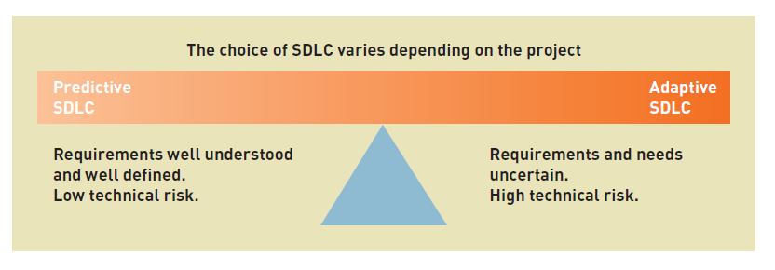
Which one is better?
COMPUTER INFORMATION SYSTEM DEPARTMENT ASS.LEC. ZAINAB H. ALFAYEZ

Slide 5
Phases of System Development Project
The development of a new information system requires a number of different but related sets of activities.
Provide the framework for managing the project.
COMPUTER INFORMATION SYSTEM DEPARTMENT ASS.LEC. ZAINAB H. ALFAYEZ

Slide 6
Phases of System Development Project
Project initiation: identifies the problem and secures approval to develop a new system.
Project planning: involves planning, organizing, and scheduling the project.
Analysis: focuses on discovering and understanding the details of the problem or need.
Design: focuses on configuring and structuring the new system components.
Implementation: includes programming and testing the system.
Deployment: involves installing and putting the system into operation.
Support phase: includes the activities needed to upgrade and maintain the system after it has been deployed.
COMPUTER INFORMATION SYSTEM DEPARTMENT ASS.LEC. ZAINAB H. ALFAYEZ

Slide 7
Waterfall Model
Example of predictive SDLC approach.
This model assumes that the phases can be carried out and completed sequentially.
After a project drops over the waterfall into the next phase, there is no going back.
The waterfall model assumes rigid planning and final decision-making at each step of the development project.
The waterfall model doesn’t always work very well… Why?
COMPUTER INFORMATION SYSTEM DEPARTMENT ASS.LEC. ZAINAB H. ALFAYEZ

Slide 8
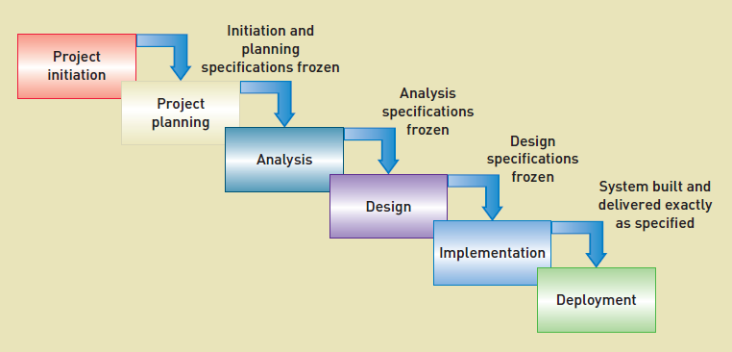
Predictive SDLC approach
COMPUTER INFORMATION SYSTEM DEPARTMENT ASS.LEC. ZAINAB H. ALFAYEZ

